Slide 1




NEXT GEN EMPLOYABILITY PROGRAM
Creating a future-ready workforce
Team Members
College Name
Student Name :
Student ID :
Xyz

Slide 2

CAPSTONE PROJECT SHOWCASE
Project Title
voting application using django framework-NITHISH(4025,SEC)
Abstract | Problem Statement | Project Overview | Proposed Solution | Technology Used | Modelling & Results | Conclusion

Slide 3
Abstract
This abstract introduces a Django-powered voting system tailored to enhance democratic participation and ensure the integrity of electoral processes.
Leveraging Django's robust framework, the system provides a secure, user-friendly platform for voters to cast their ballots while maintaining transparency and accountability.
Source :

Slide 4
Problem Statement
Despite the advancements in technology, many democratic processes still suffer from inefficiencies, vulnerabilities, and barriers to participation.
Traditional voting systems often lack transparency, are susceptible to tampering, and may exclude certain segments of the population.
Addressing these challenges requires the development of a robust, secure, and accessible voting application.
Source :

Slide 5
Project Overview
The project aims to develop a Django-based online voting application to facilitate democratic:
participation
ensure the integrity of electoral processes
promote transparency
accessibility in voting.
Source :

Slide 6
Proposed Solution
The proposed solution is to develop a robust, secure, and user-friendly online voting application using the Django framework.
This solution addresses the key objectives of modernizing the electoral process while ensuring security, transparency, and accessibility for all users.
.
Source :

Slide 7


Technology Used
Front-end
Back-end
Source :

Slide 8
Modelling & Results
Problem Formulation: Clearly define the problem you're trying to solve or the question you're trying to answer. This involves understanding the objectives, identifying relevant variables, and specifying the scope of the analysis.
Data Collection and Preprocessing: Gather the necessary data from various sources, ensuring its quality and reliability. Preprocess the data by cleaning, transforming, and formatting it to make it suitable for analysis. This may involve handling missing values, removing outliers, and normalizing or standardizing the data.
Exploratory Data Analysis (EDA): Explore the data to gain insights into its characteristics, relationships, and patterns. This typically involves visualizing the data using graphs, charts, and summary statistics to identify trends, correlations, and potential variables of interest.
Feature Selection and Engineering: Select relevant features (variables) for the analysis and engineer new features if needed to enhance the predictive power of the model. This may involve techniques such as dimensionality reduction, encoding categorical variables, and creating interaction terms.
Model Selection: Choose appropriate modeling techniques based on the nature of the problem, the available data, and the desired outcomes. This could include regression, classification, clustering, or time series analysis, among others. Consideration should be given to both traditional statistical models and machine learning algorithms.
Model Training and Validation: Split the data into training and validation sets to train the model on one subset and evaluate its performance on another. This helps to assess how well the model generalizes to new data and to detect potential overfitting or underfitting issues.
Source :

Slide 9
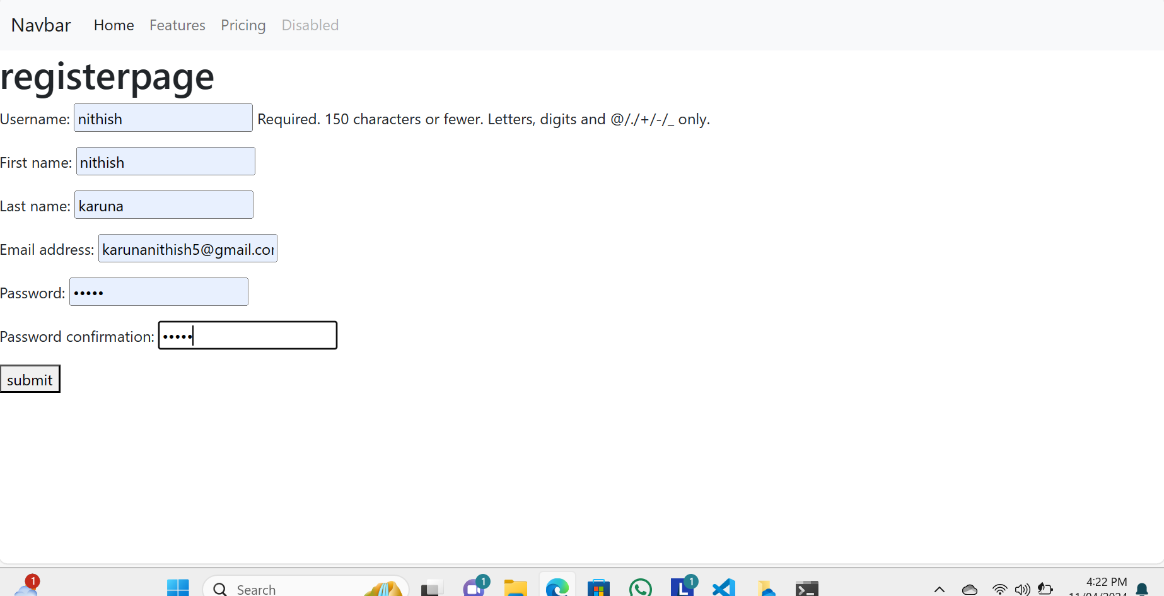
Register page

Slide 10

Login page

Slide 11

Home page

Slide 12
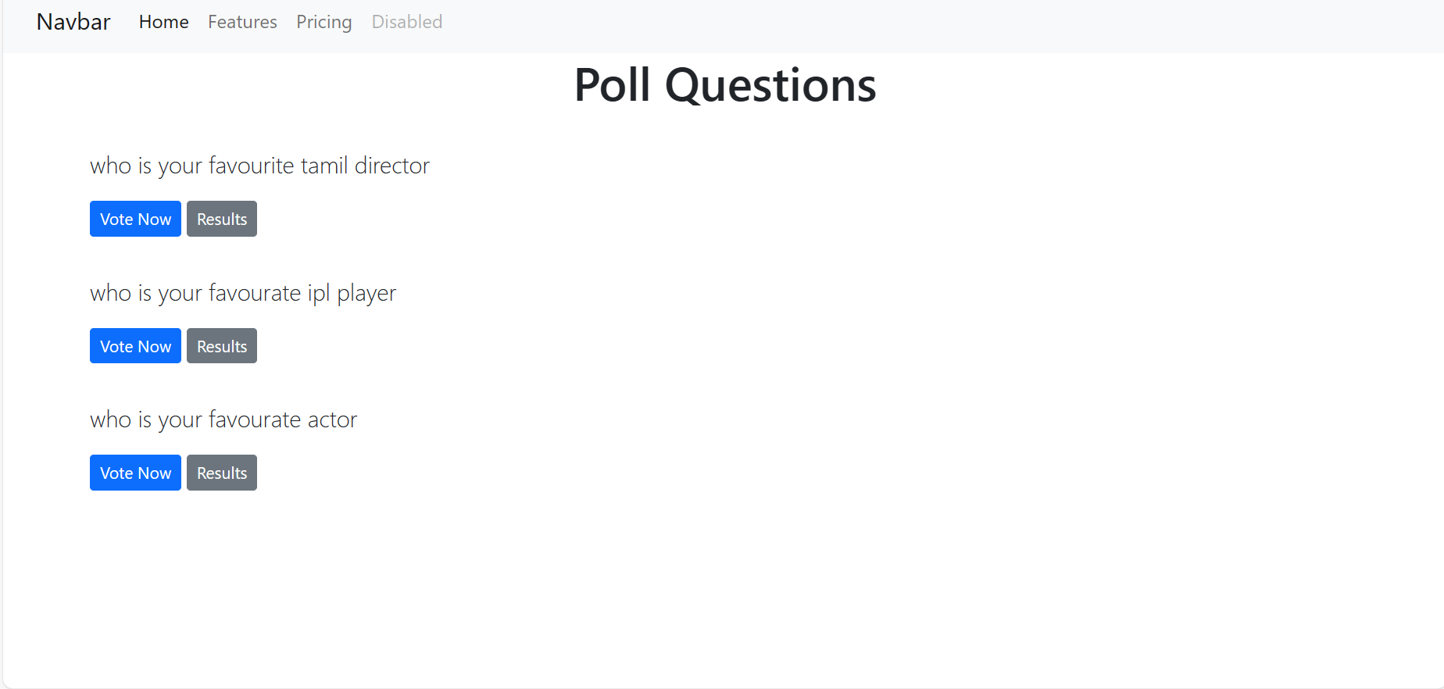
Poll questions

Slide 13
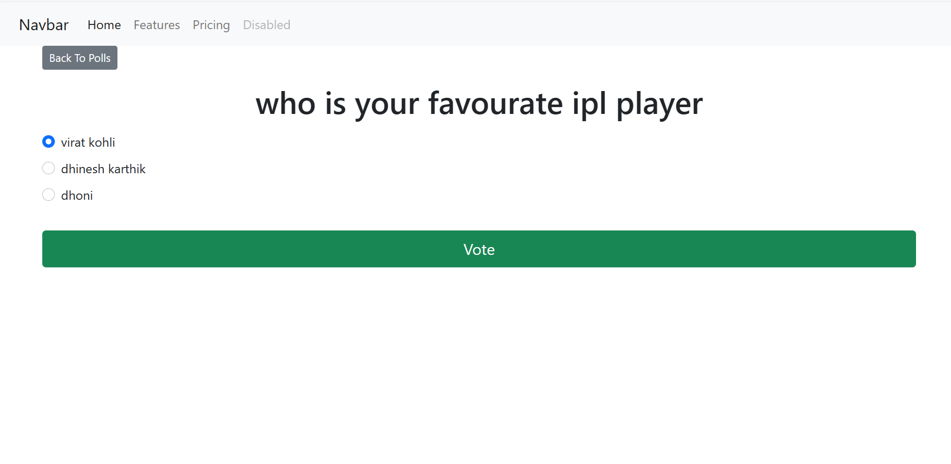
Server page

Slide 14
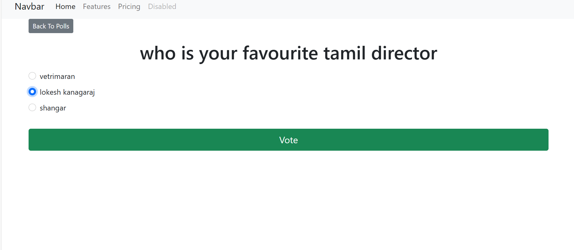

Slide 15
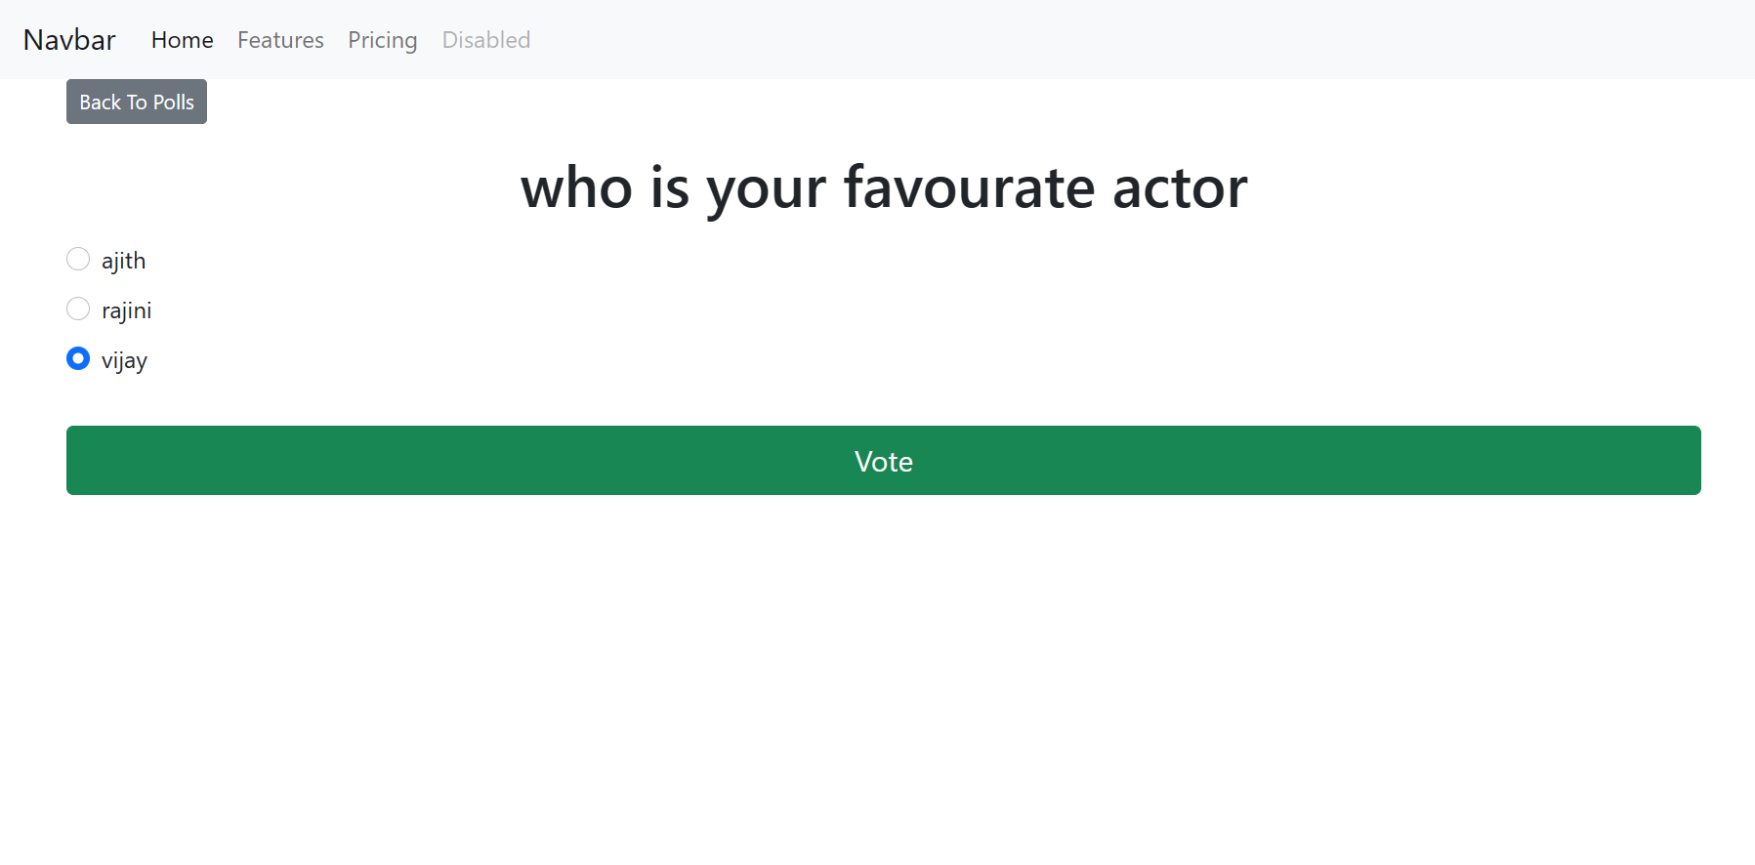

Slide 16
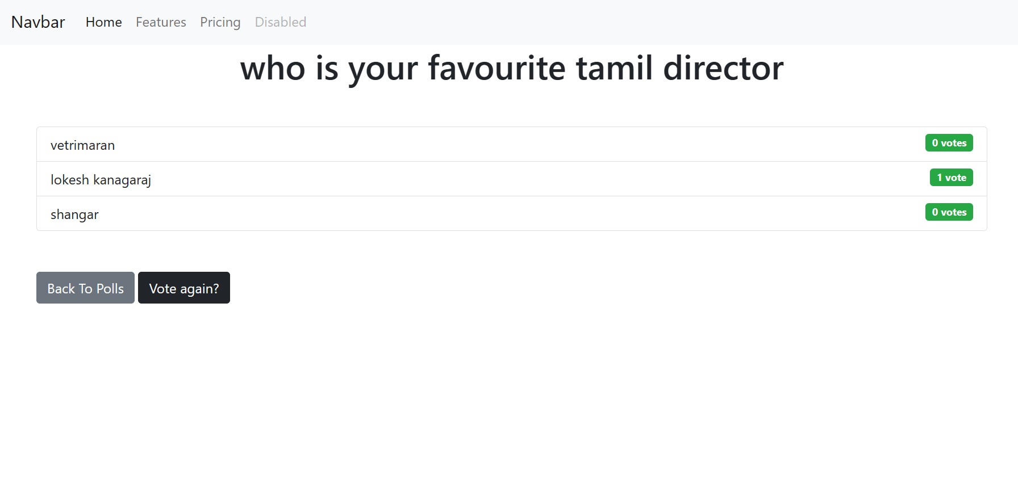
Result page

Slide 17
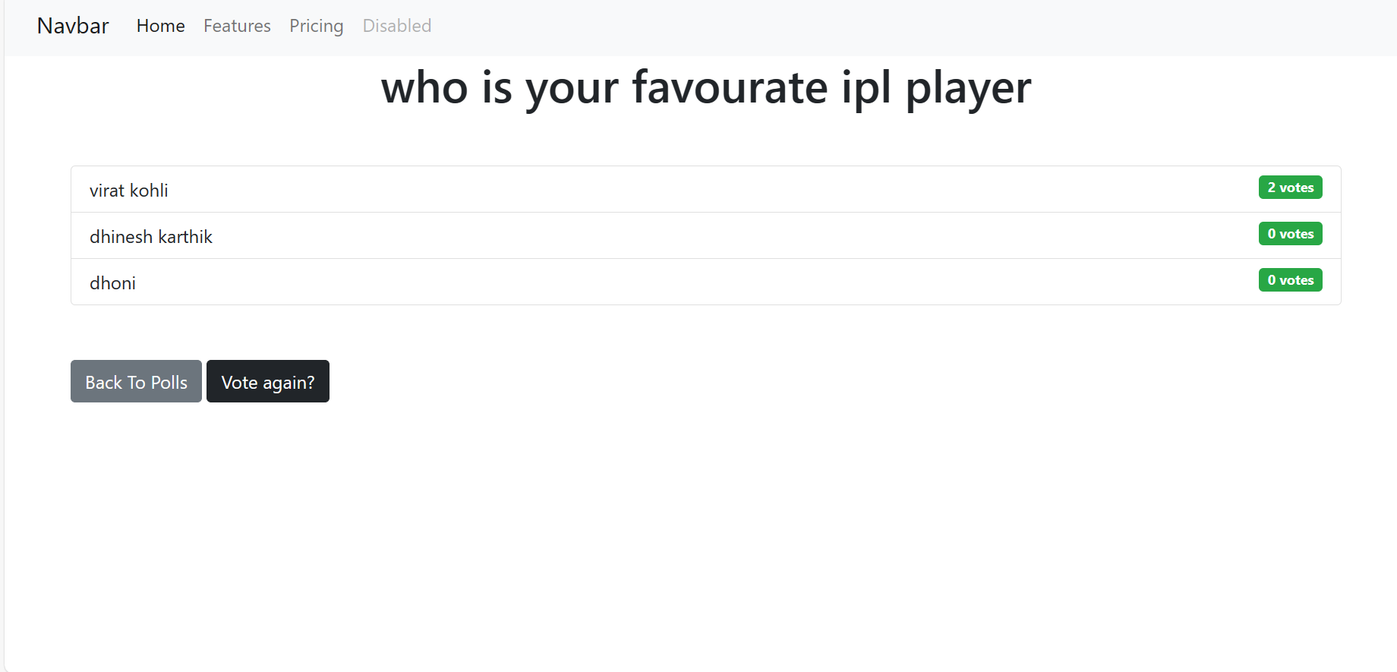

Slide 18
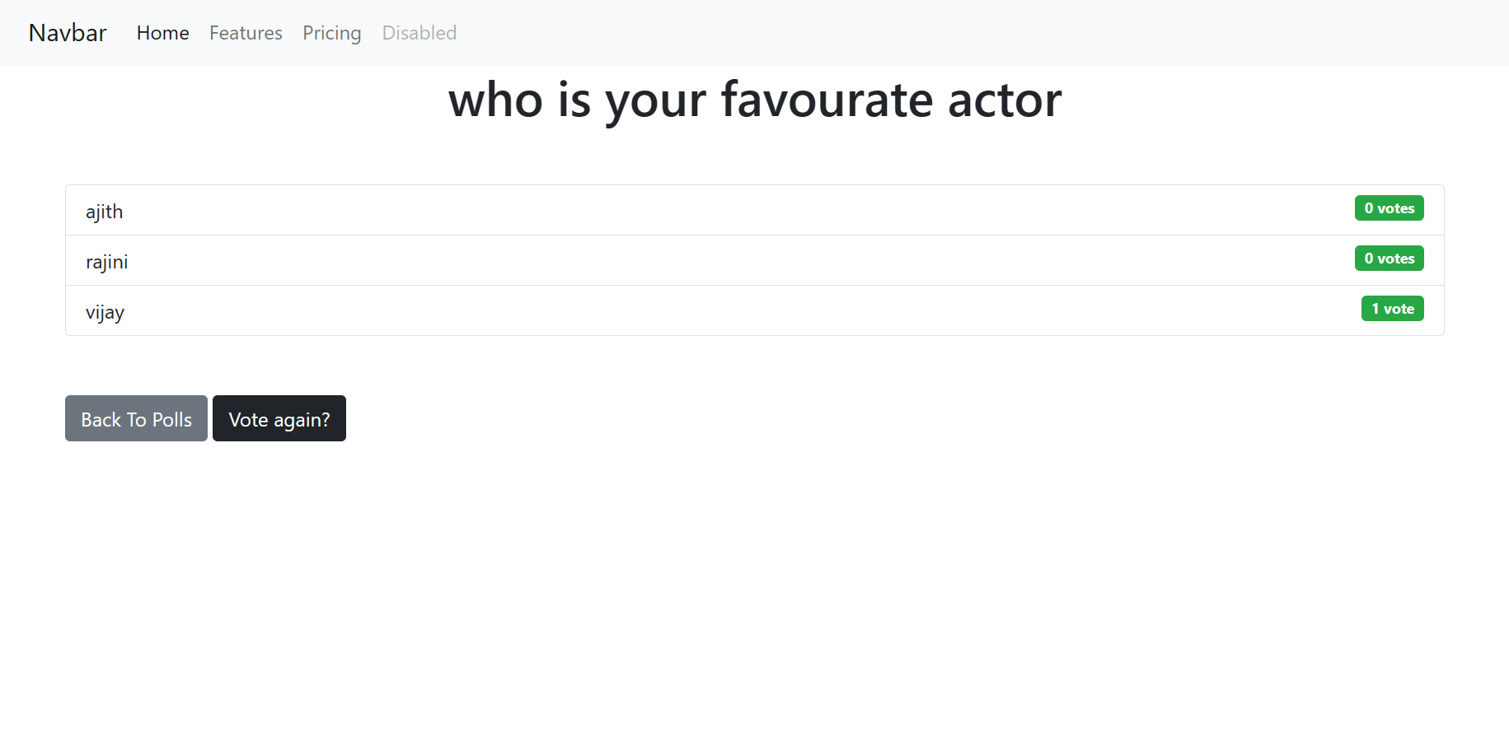

Slide 19
Future Enhancements:
Future enhancements in modeling and analyzing data are likely to focus on improving the accuracy, efficiency, and interpretability of models, as well as addressing emerging challenges and opportunities in data science. Here are some potential areas for future enhancements

Slide 20
Conclusion
conclusion, the future of data science and machine learning holds immense promise, with ongoing advancements poised to revolutionize how we analyze, model, and derive insights from data. By focusing on key areas such as interpretability, fairness, automation, privacy, and human-centric AI, we can address emerging challenges and opportunities in the field, paving the way for more intelligent, ethical, and responsible AI systems.
As we continue to push the boundaries of what is possible in data science, it's essential to remain mindful of the broader societal implications of our work. By prioritizing transparency, accountability, and inclusivity, we can ensure that AI technologies benefit everyone and contribute to a more equitable and sustainable future.
Source :

Slide 21
Thank You!
Notes:
Thank You !!

